Slide 1
DADSS
User Training & Feature Overview
CAPT DR ALEEM MUSHTAQ
DIRECTOR COMMUNICATION NRDI

Slide 2
PROJECT INTRO
Data Analysis and Decision Support System - a software that will automate the data analysis of PMSA operations being performed at PMSA Data Analysis Cell (PMSADAC)

Slide 3
Data Inputs
The application provides users to record structured reports by inputing operational and incident data.
Ensures consistent data entry while reducing errors with predefined options and validation.
Available data input forms include:
General Report
Special Reports
Mission Report
Intel Report
Shipbreaking Report
Vessels Registration forms
SAR
Notes:
The application provides users to record structured reports by inputing operational and incident data.
Ensures standardized data collection across different report types.
Reduces errors through predefined options and validation.
Submitted data is securely stored and used for analytics, reports, and mission tracking.
Available data input forms include:
General Report
Special Reports
Mission Report
Intel Report
Shipbreaking Report
Vessels Registration forms
Each form includes clear field labels and dropdowns to simplify input.
Data is validated on entry to avoid missing or incorrect values.
All submitted reports are integrated with the data visualization modules.
The system uses this data for analysis, alerts, and operational summaries.

Slide 4
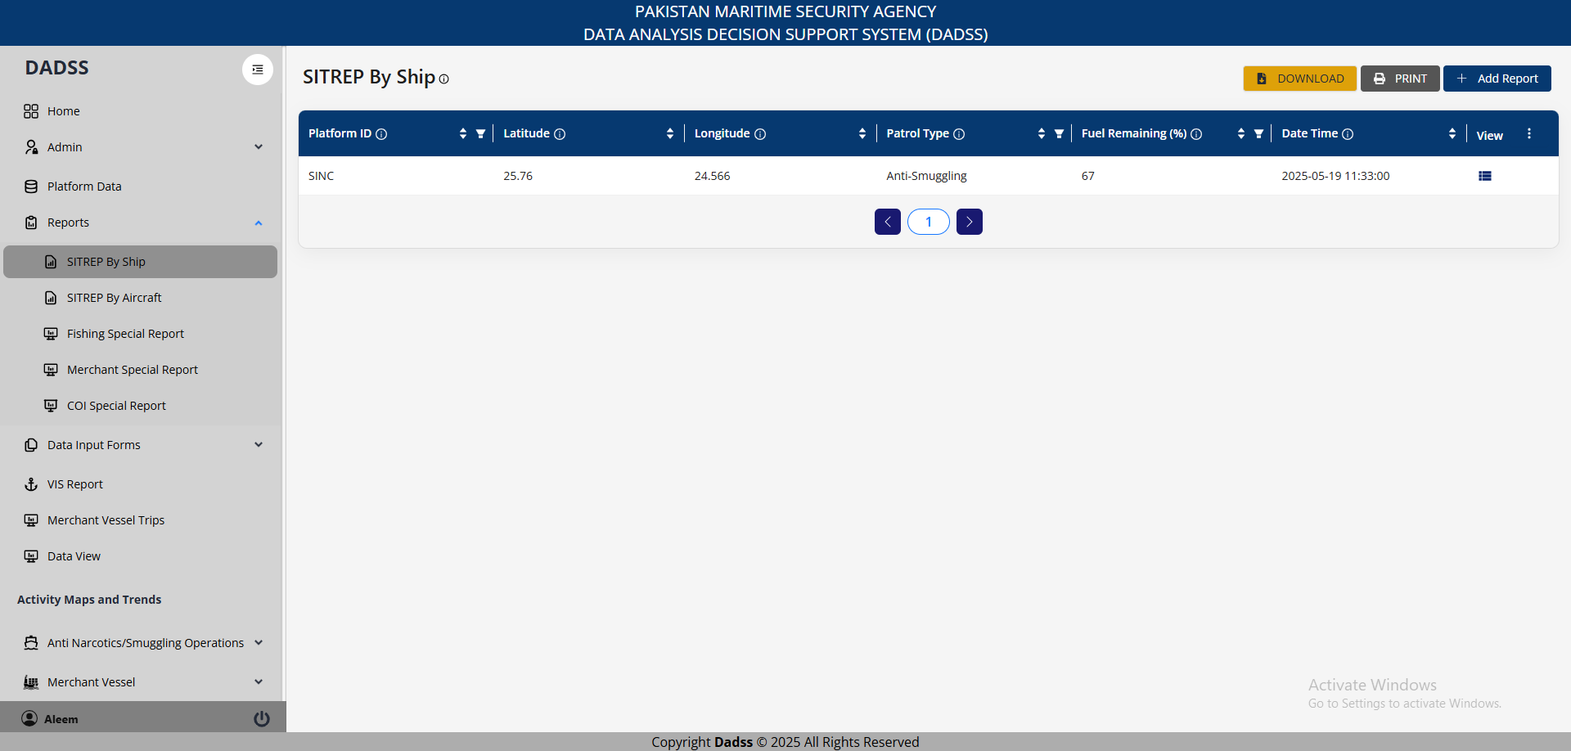
1. Situation Report (SITREP) of Surface Ships

Slide 5
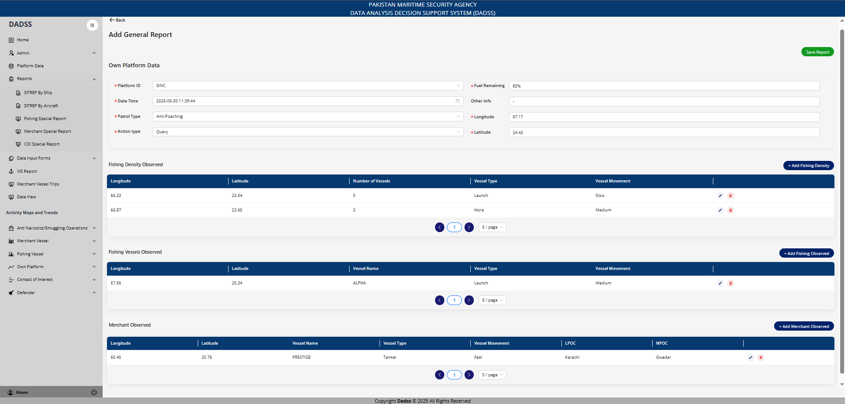
1. Situation Report (SITREP) of Surface Ships

Slide 6
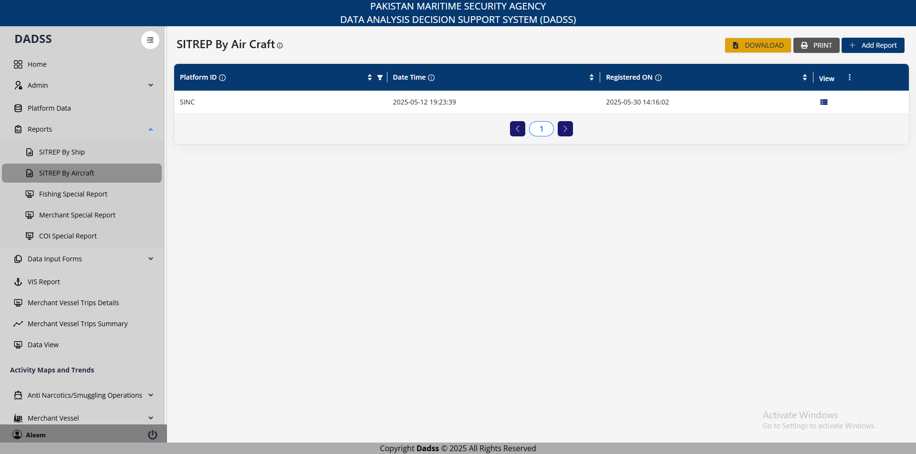
2. Mission Report of PN/PNMSA Aircrafts

Slide 7
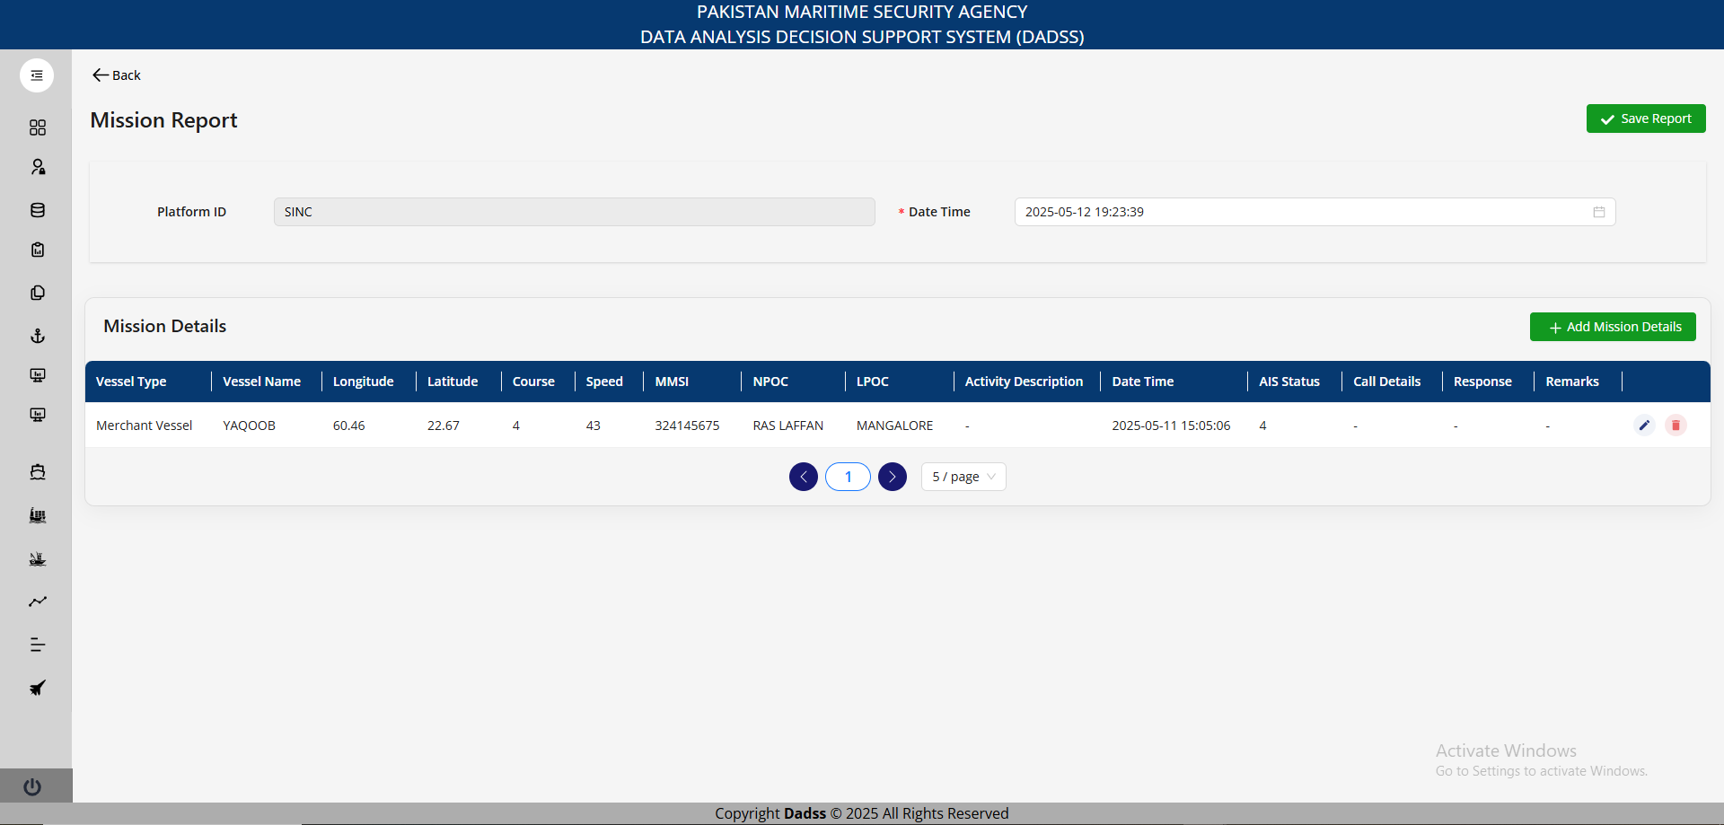
2. Mission Report of PN/PNMSA Aircrafts

Slide 8
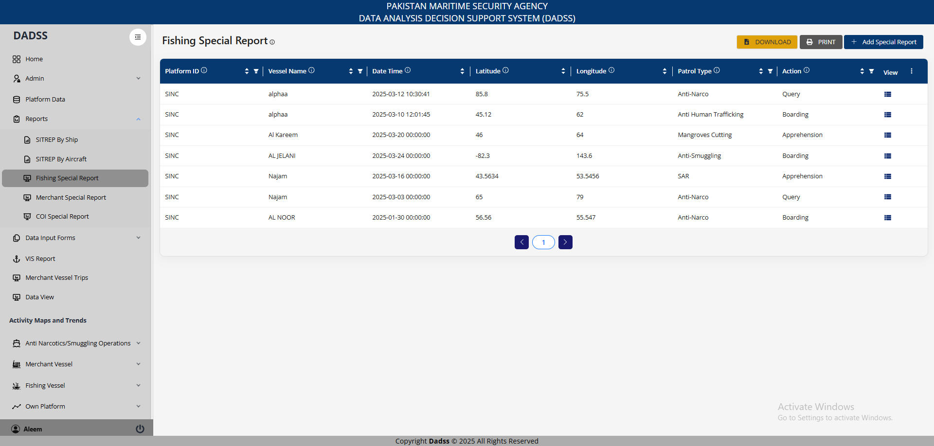
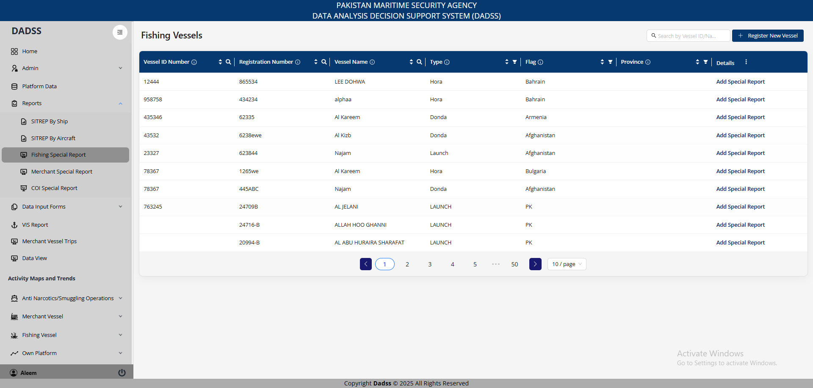
3a. Special Report (Fishing)

Slide 9
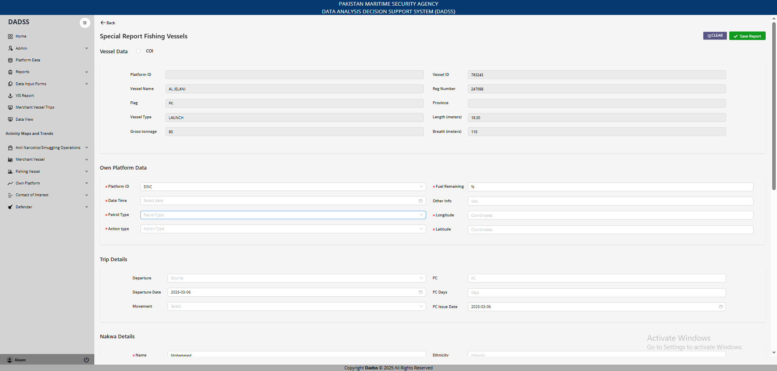
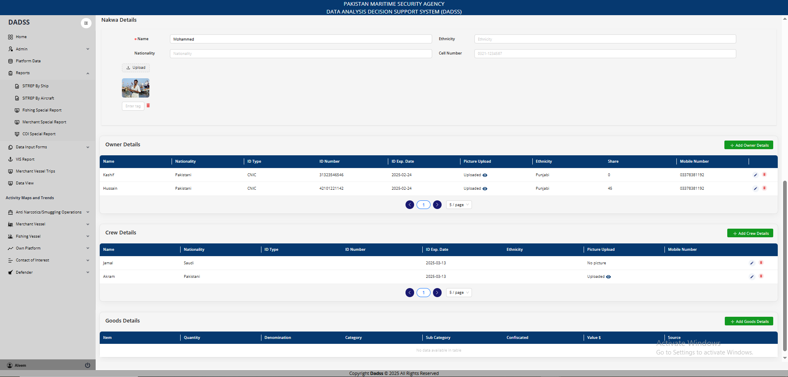
3a. Special Report (Fishing)

Slide 10
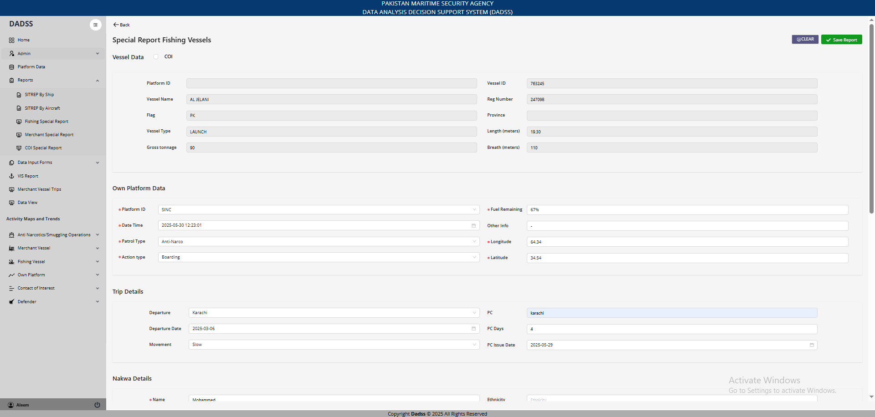
3a. Special Report (Fishing)

Slide 11
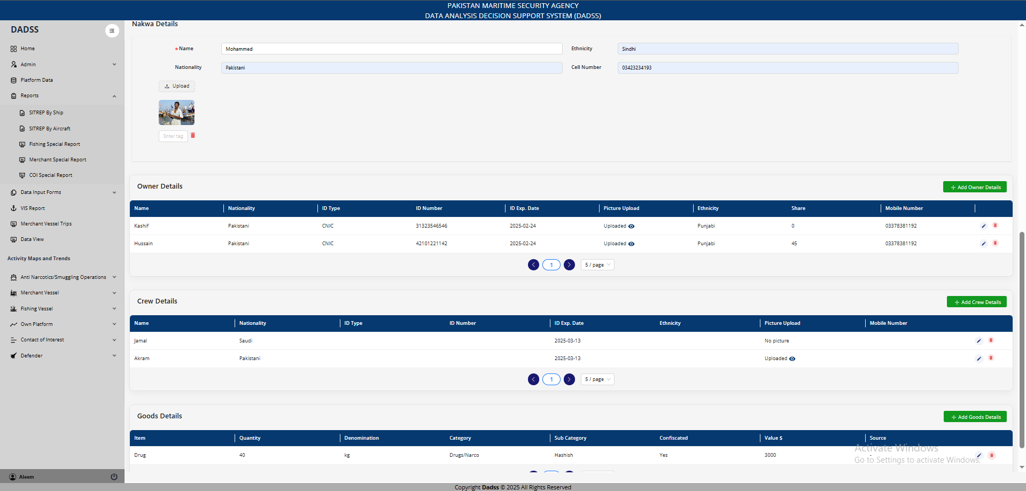
3a. Special Report (Fishing)

Slide 12
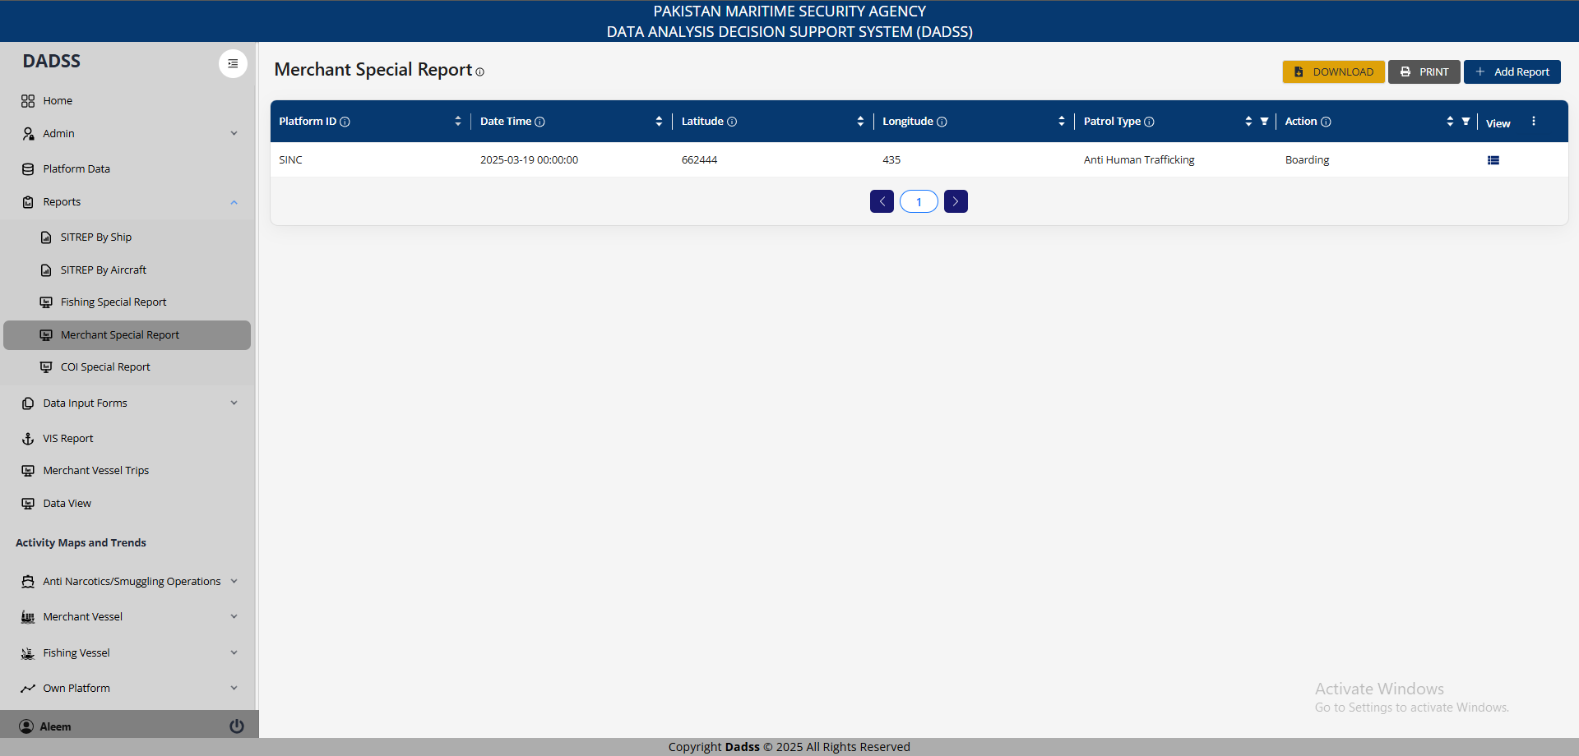
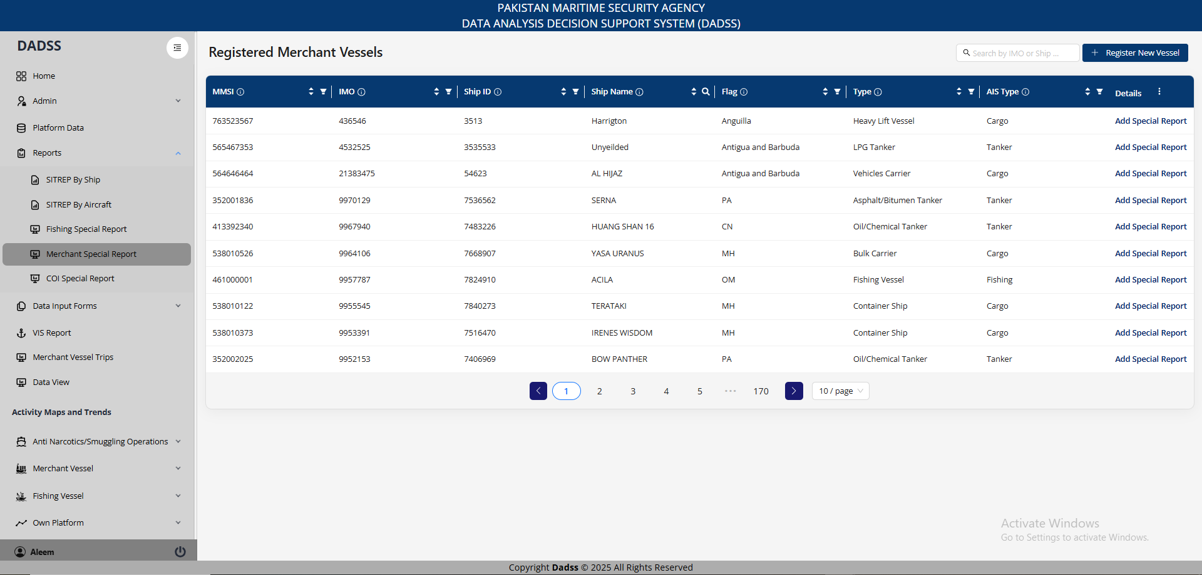
3b. Special Report (Merchant)

Slide 13
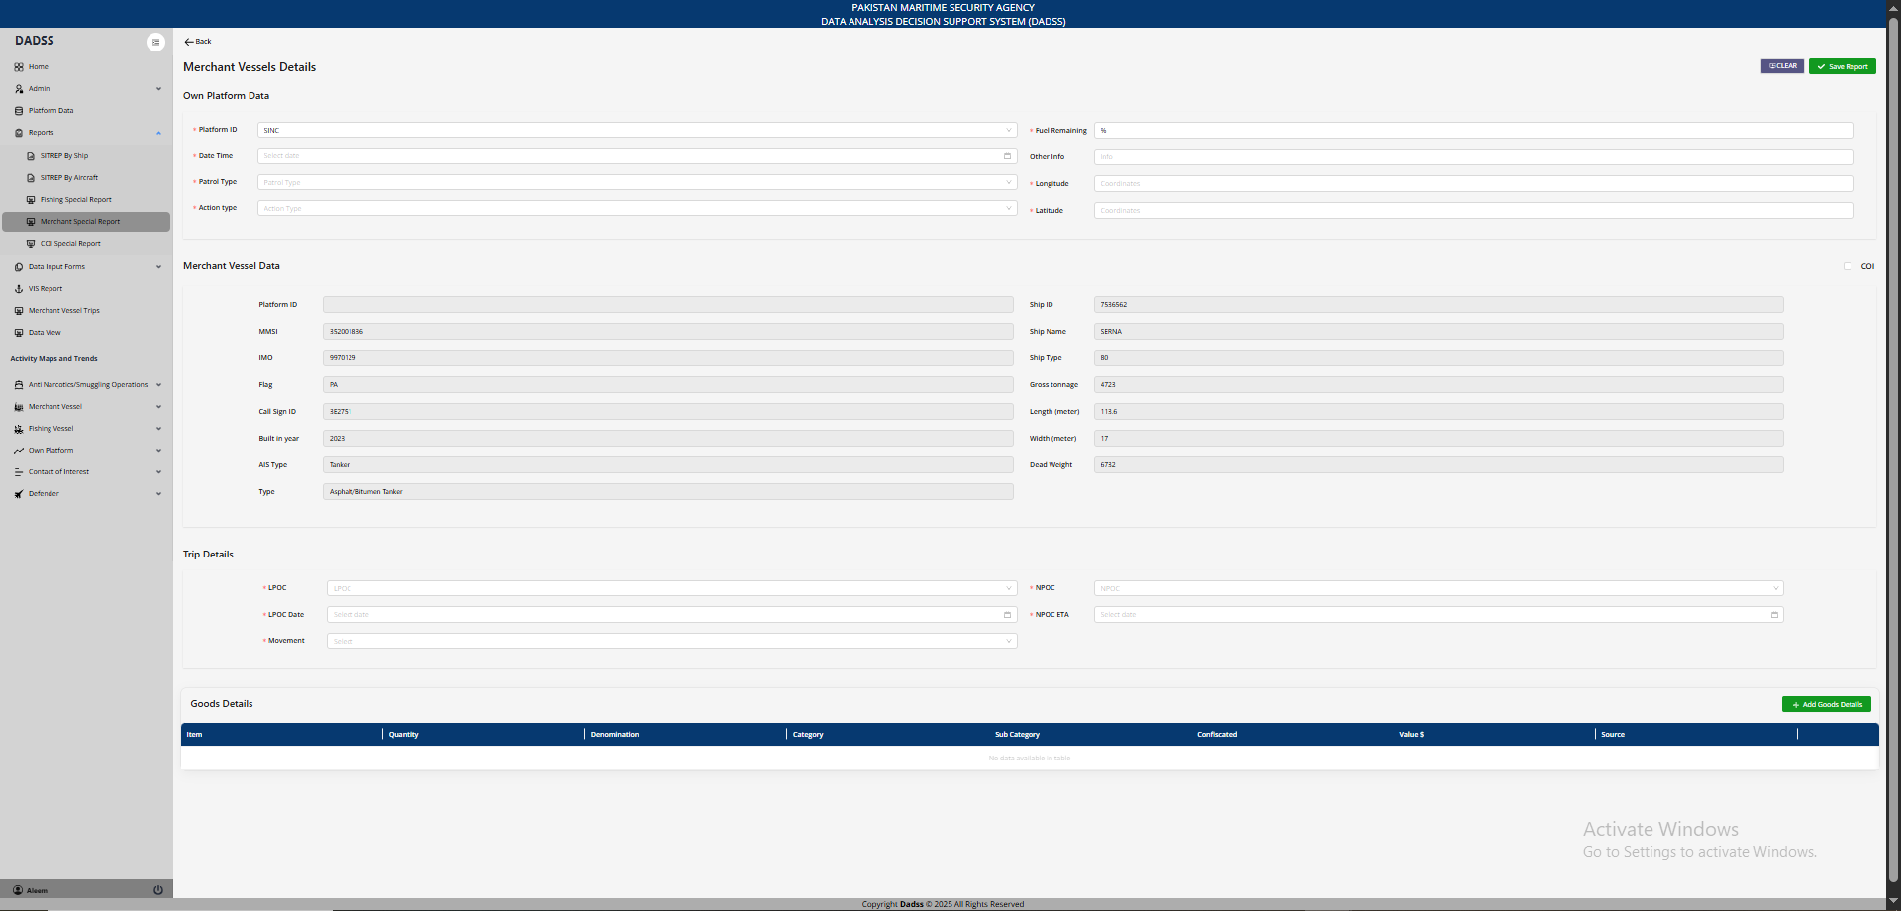
3b. Special Report (Merchant)

Slide 14
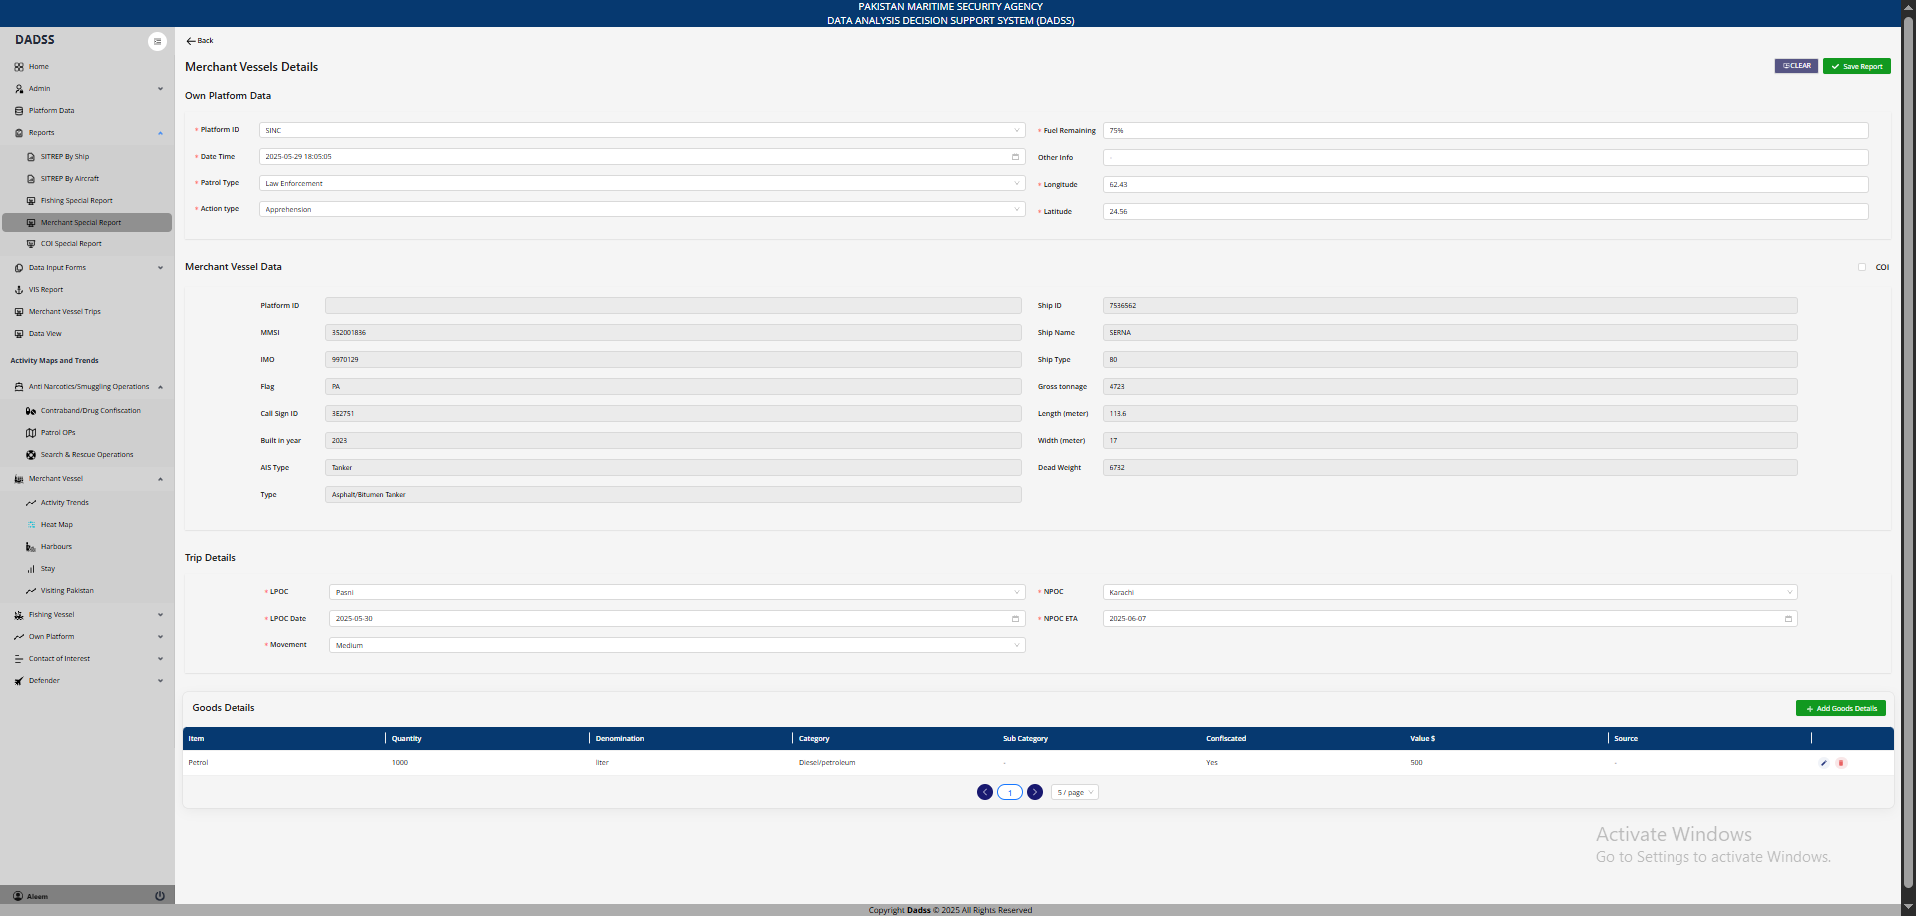
3b. Special Report (Merchant)

Slide 15
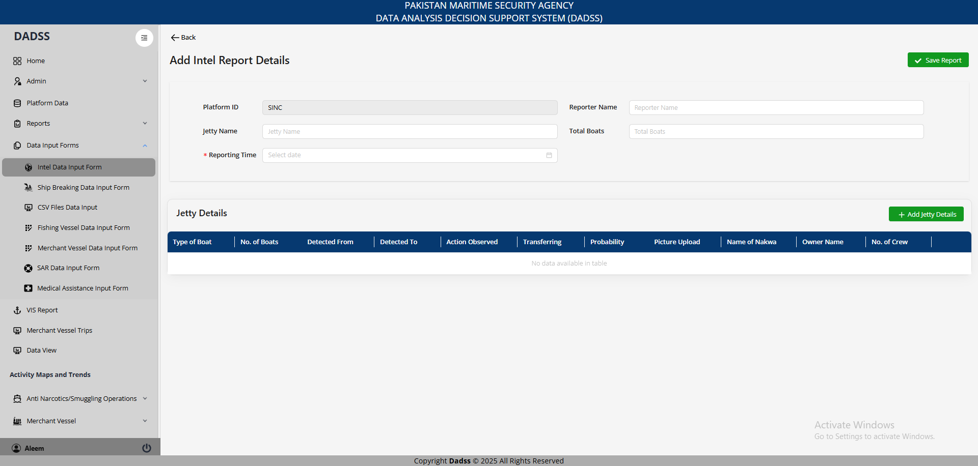
4. Intel Report

Slide 16
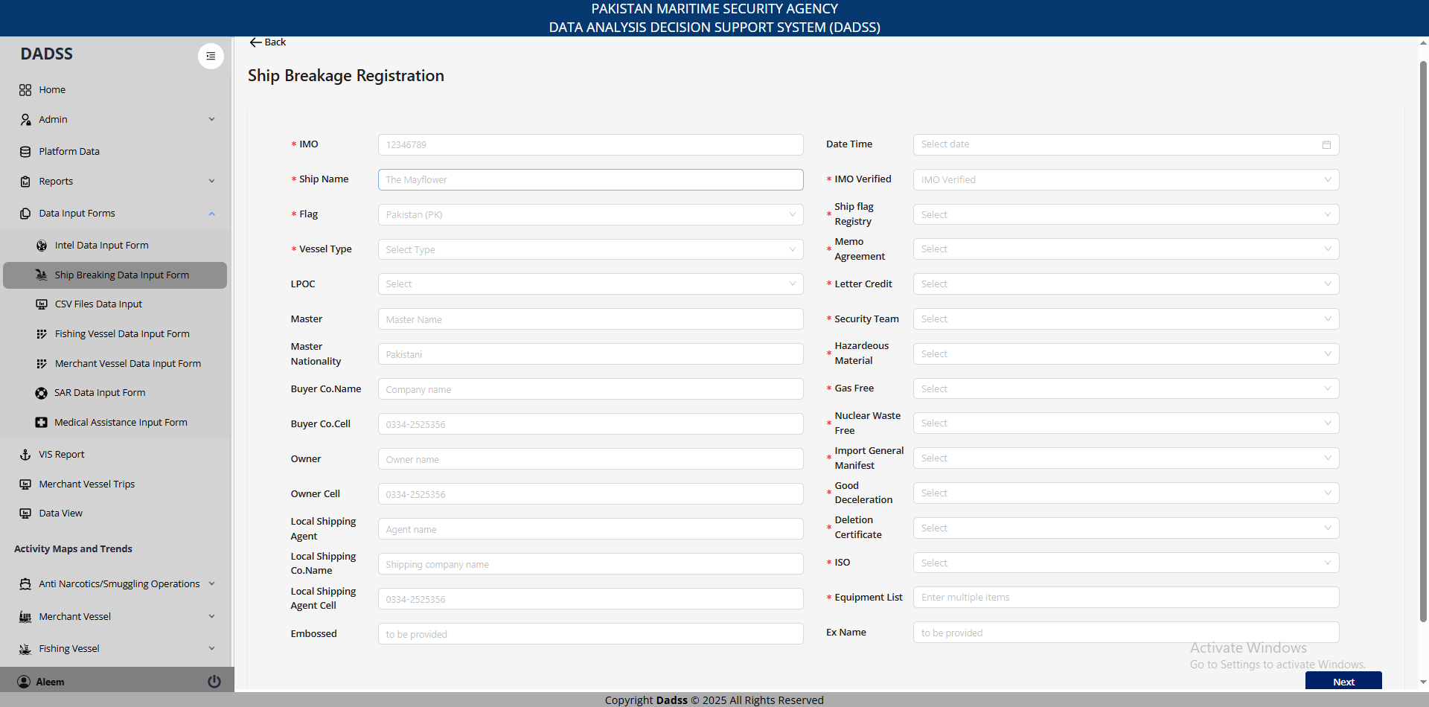
5. Ship Breaking

Slide 17
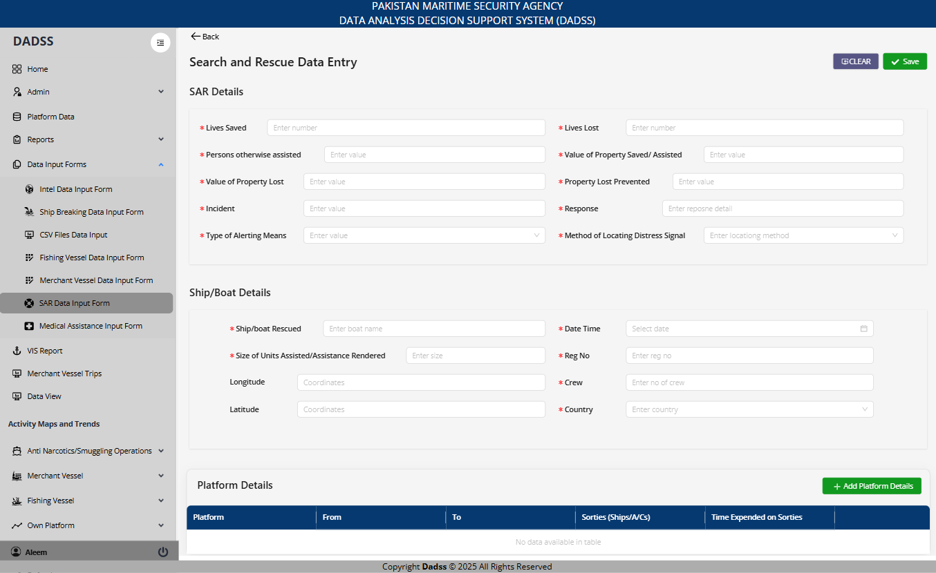
5. SAR Form

Slide 18
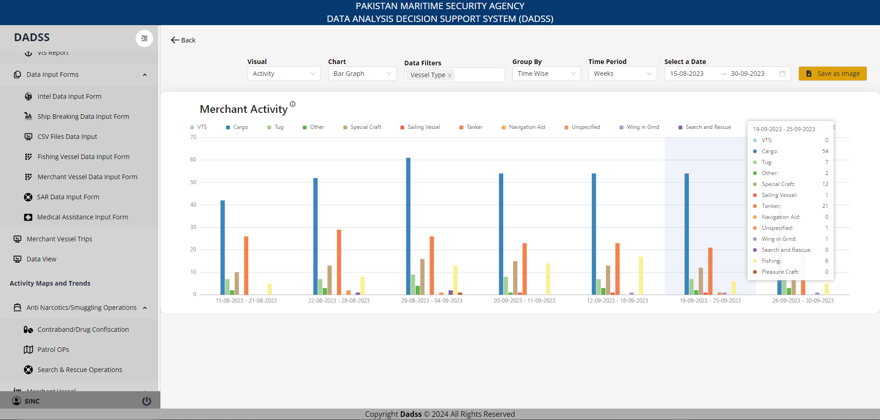
Visuals for Data Analysis
1- Visual Types Available
Charts & Graphs:
Bar Graph
Stacked Bar
Grouped Bar
Line Chart
Pie Chart
Sunburst Diagram
Geospatial Visuals:
Heatmap
Dot Map
Choropleth
2- X-Axis Customization
Change the X-axis based on:
Time (Month / Week / Day)
Harbor
Vessel Type
3- Group data by:
Time Periods
Vessel Types
Harbors / Locations
4- Filtering Capabilities:
Date Range Selector
Harbor
Vessel Type
Flags
Quantity / Value Range
Notes:
The application provides users to record structured reports by inputing operational and incident data.
Ensures standardized data collection across different report types.
Reduces errors through predefined options and validation.
Submitted data is securely stored and used for analytics, reports, and mission tracking.
Available data input forms include:
General Report
Special Reports
Mission Report
Intel Report
Shipbreaking Report
Vessels Registration forms
Each form includes clear field labels and dropdowns to simplify input.
Data is validated on entry to avoid missing or incorrect values.
All submitted reports are integrated with the data visualization modules.
The system uses this data for analysis, alerts, and operational summaries.

Slide 19
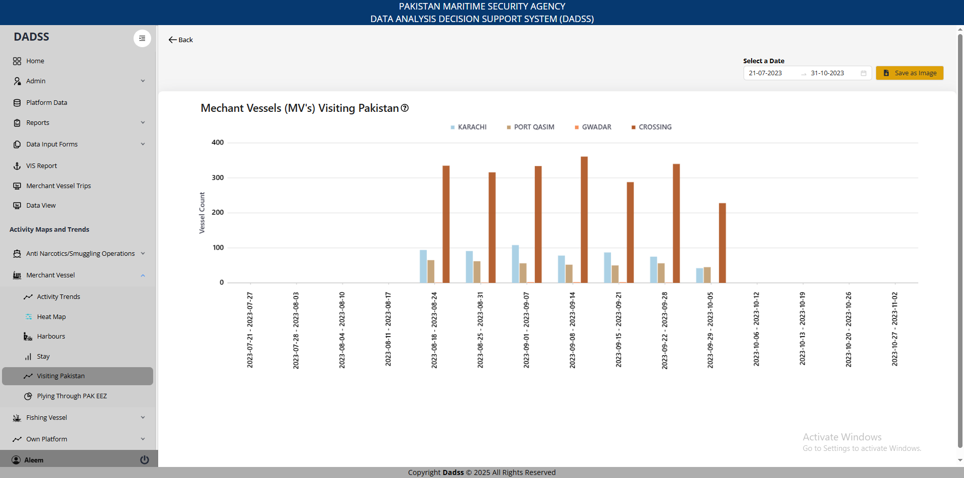
1. MVs visiting Pakistan

Slide 20
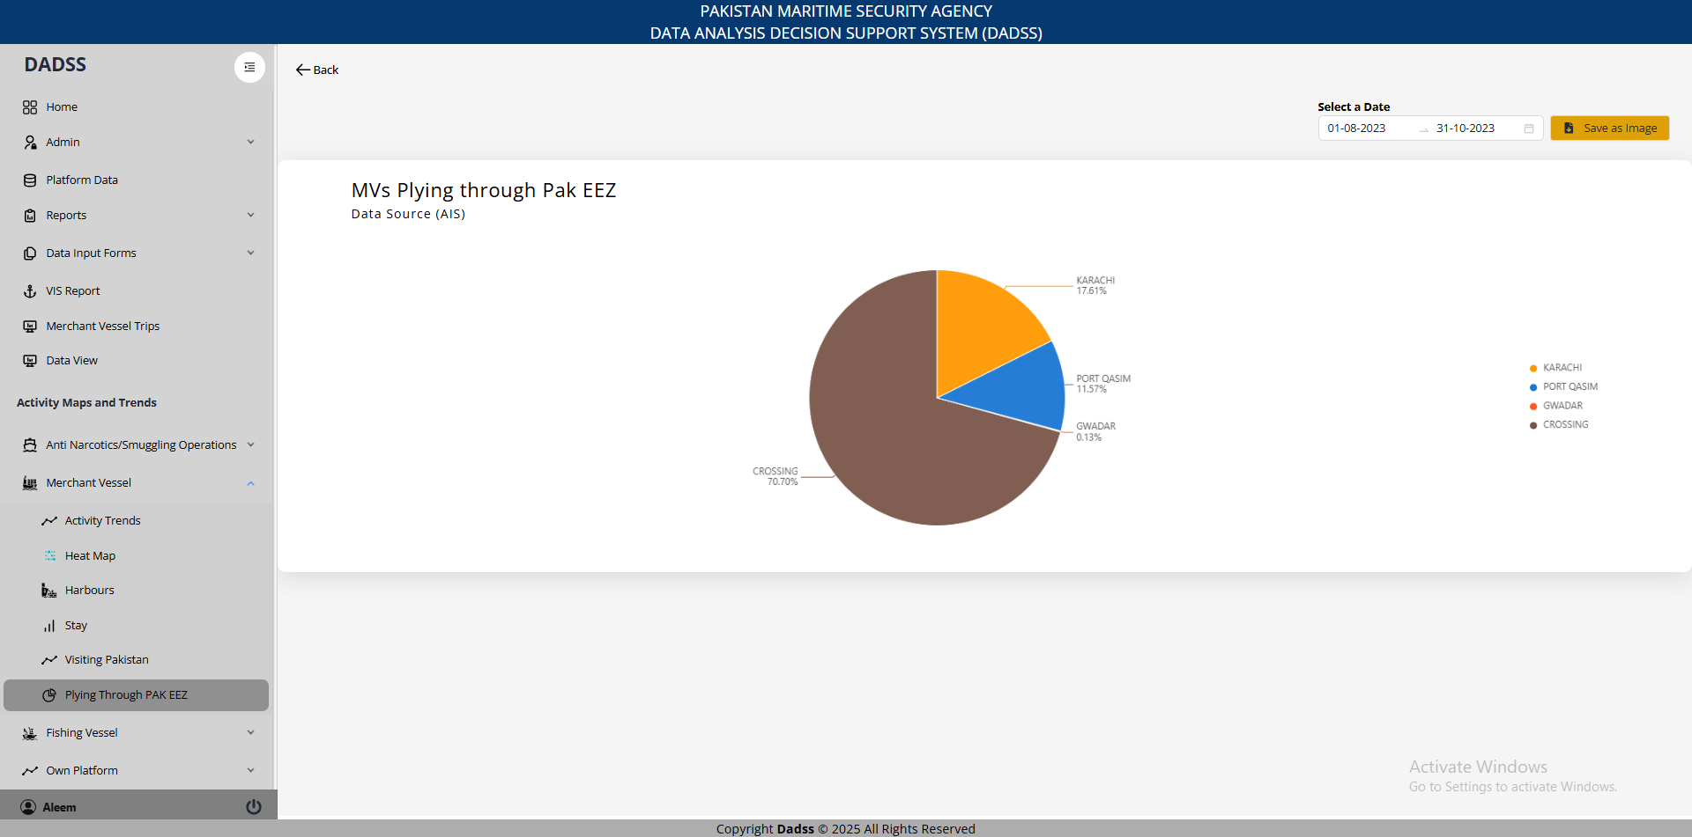
2. MVs Plying through Pak EEZ

Slide 21
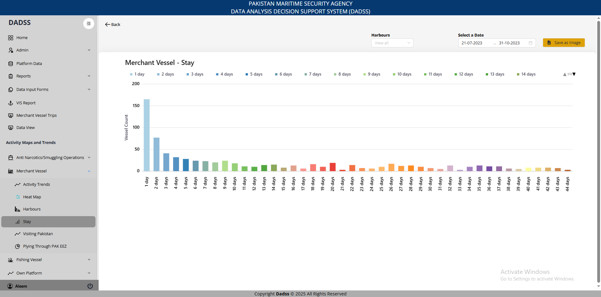
3. MVs Stay

Slide 22
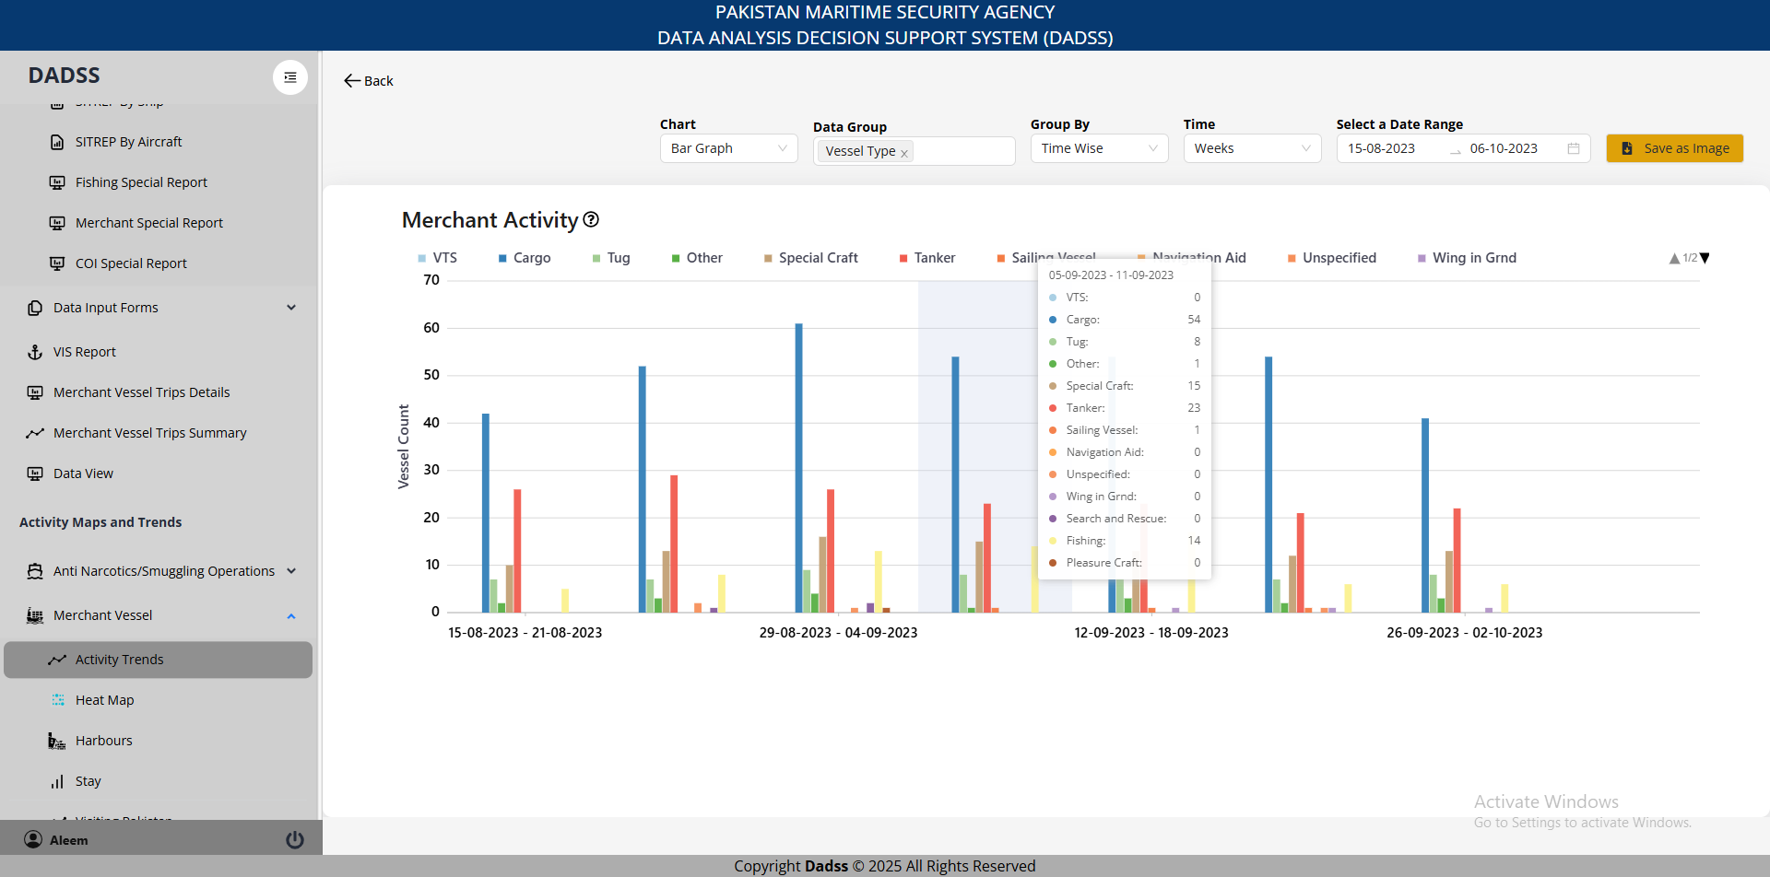
4. MVs Activity

Slide 23
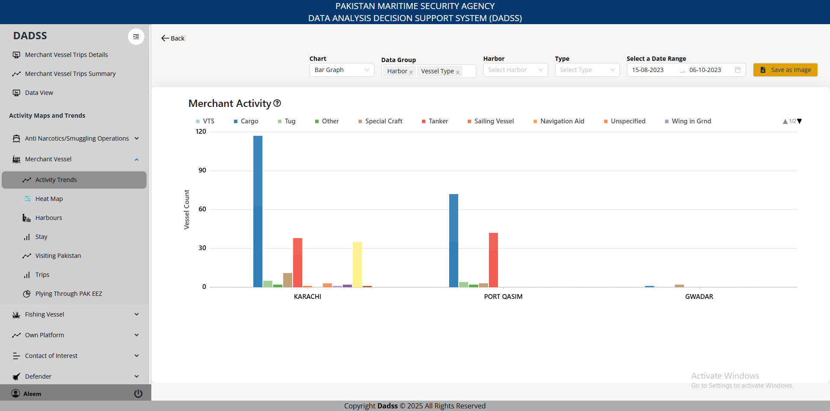
4. MVs Activity

Slide 24
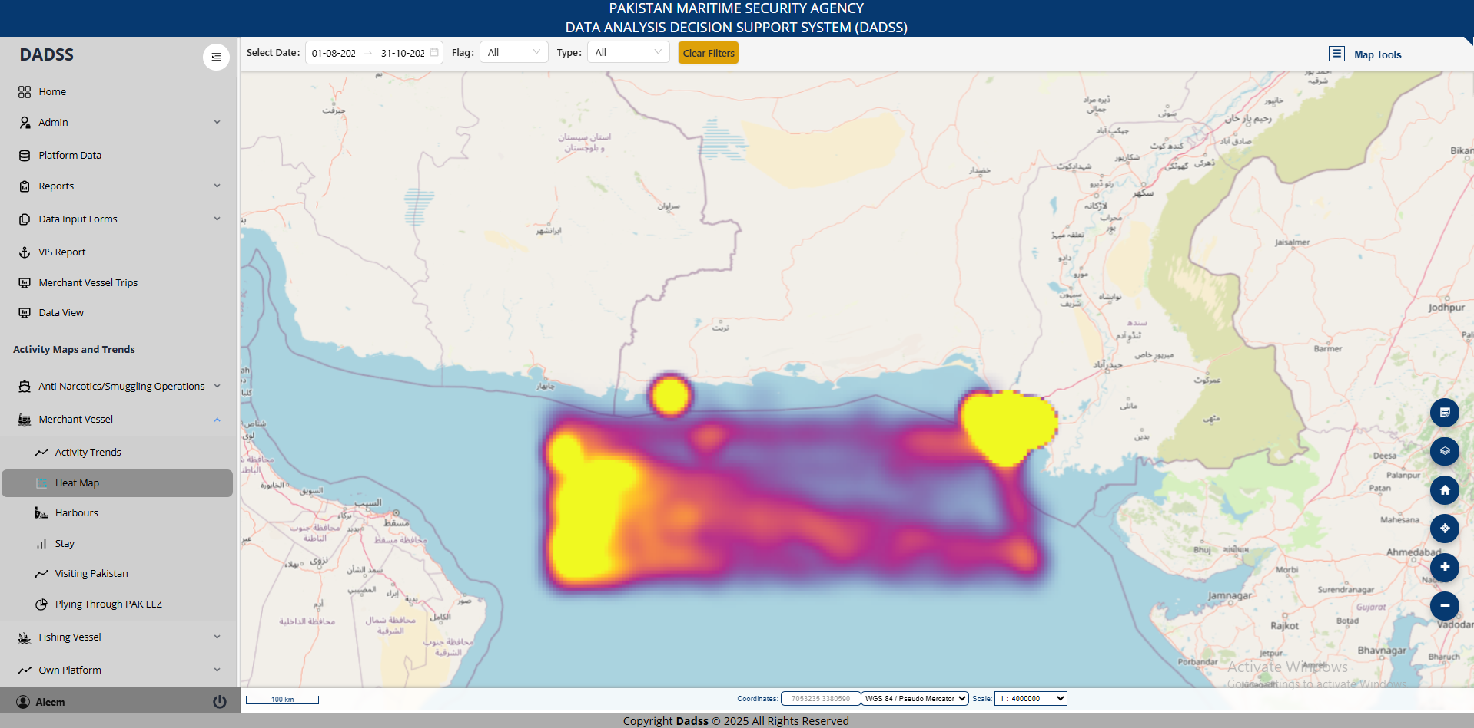
5. MVs Heatmap (AIS)

Slide 25
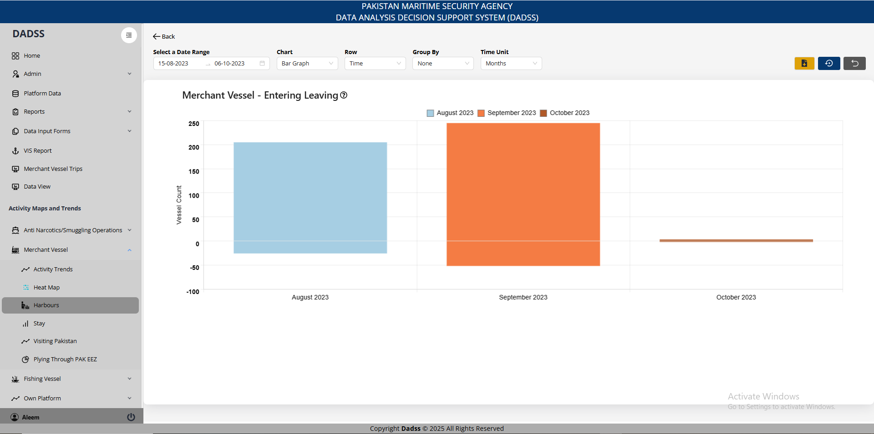
6. Merchant Entering/Leaving

Slide 26
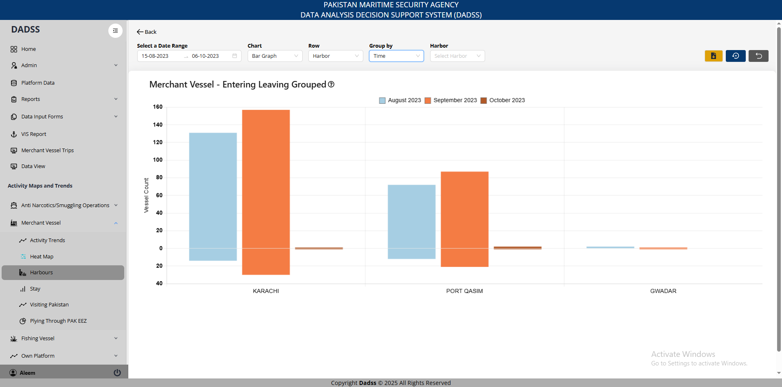
6. Merchant Entering/Leaving

Slide 27
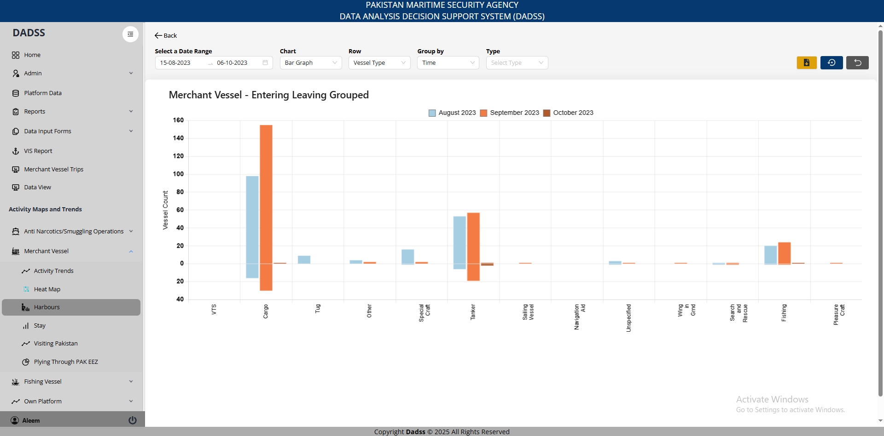
6. Merchant Entering/Leaving

Slide 28
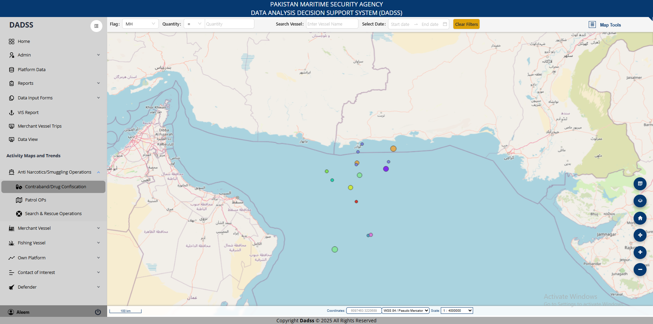
7. Contraband/Drug Confiscation

Slide 29
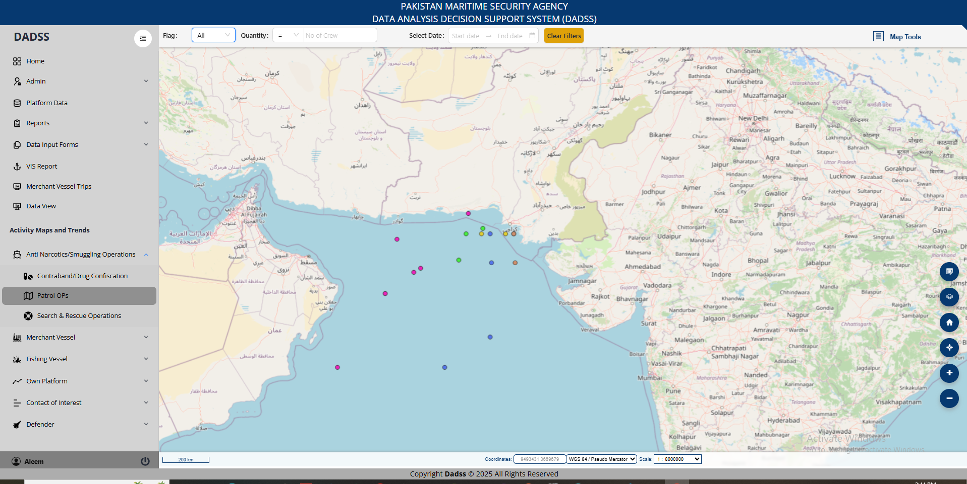
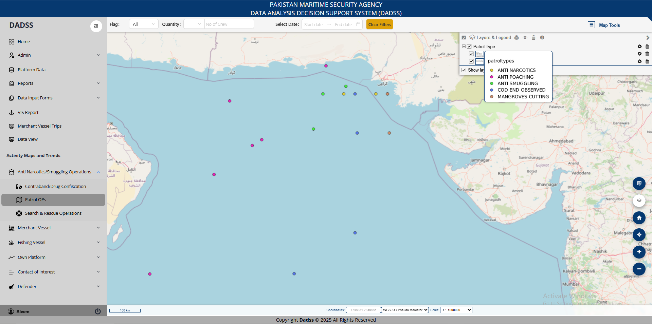
8. Operations (Query, Boarding, Apprehension)

Slide 30
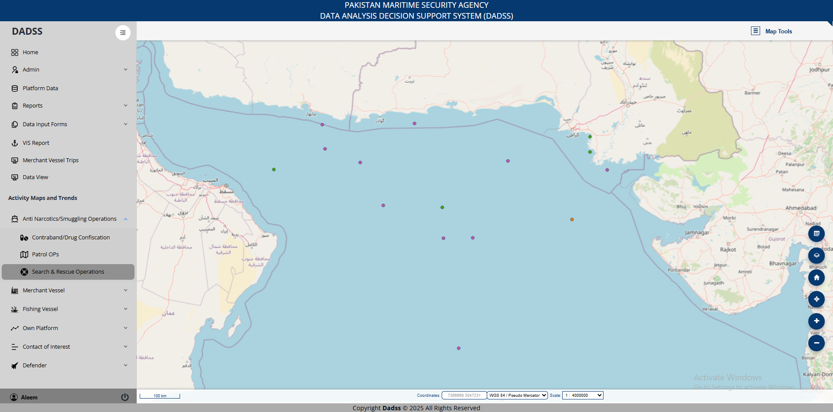
9. SAR

Slide 31
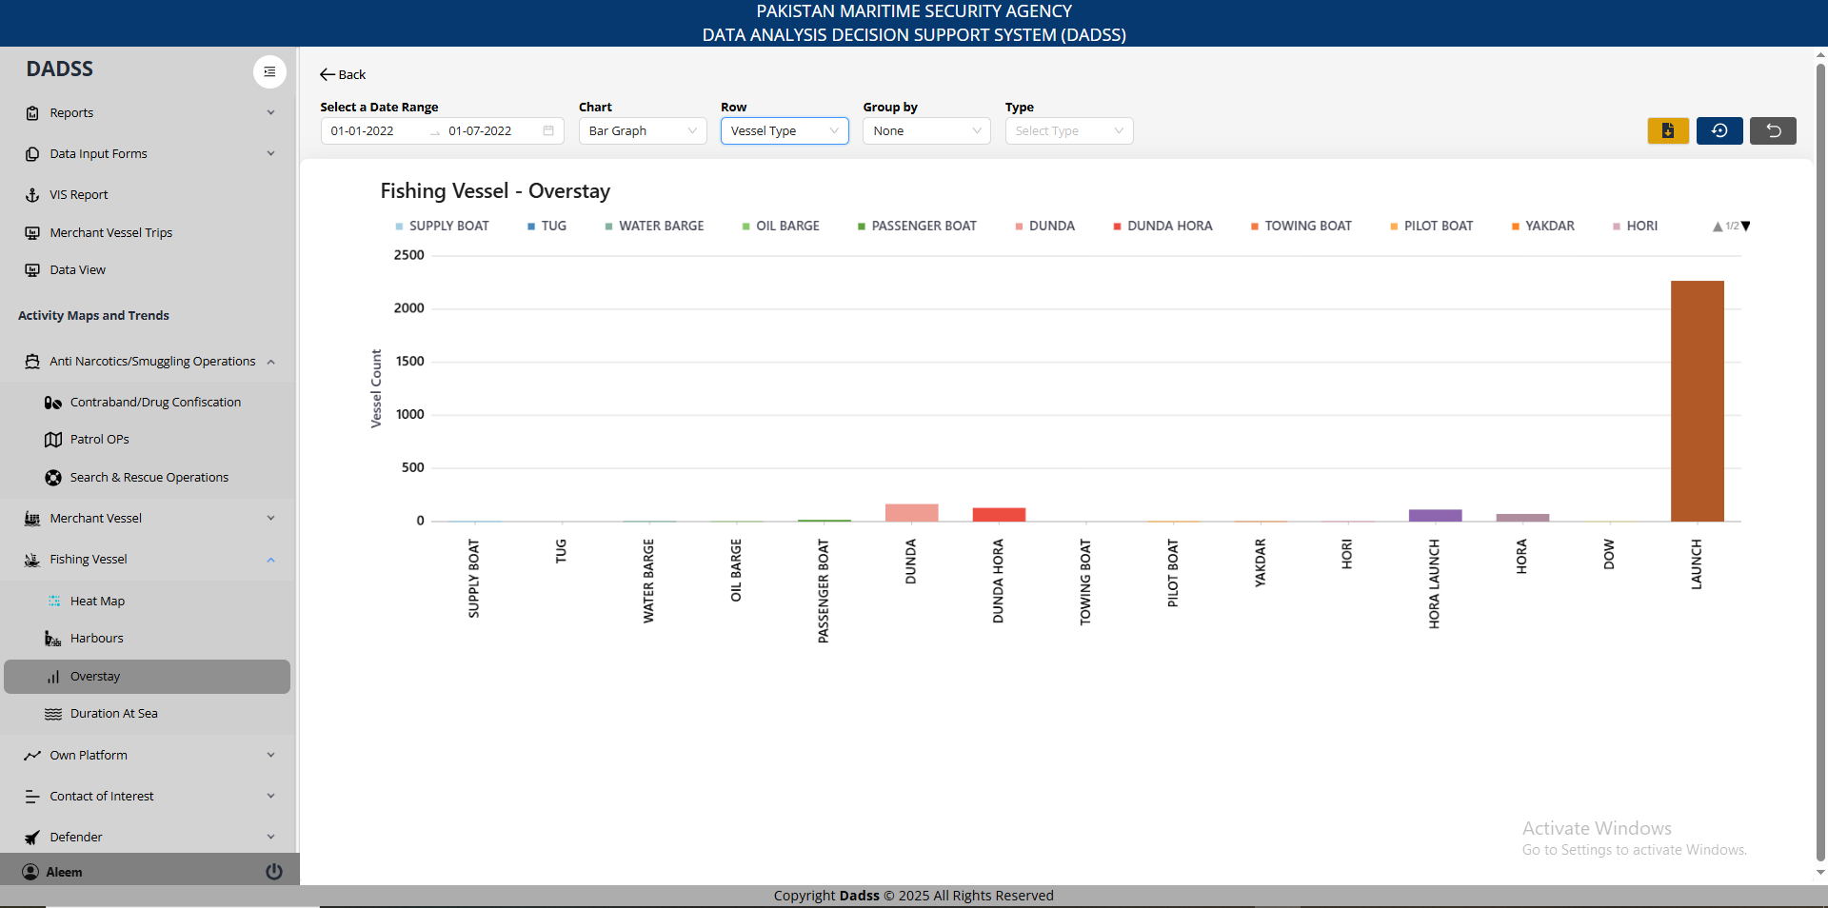
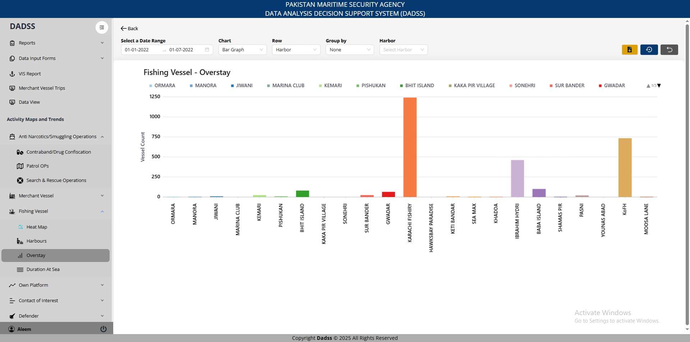
10. FVs Overstay

Slide 32
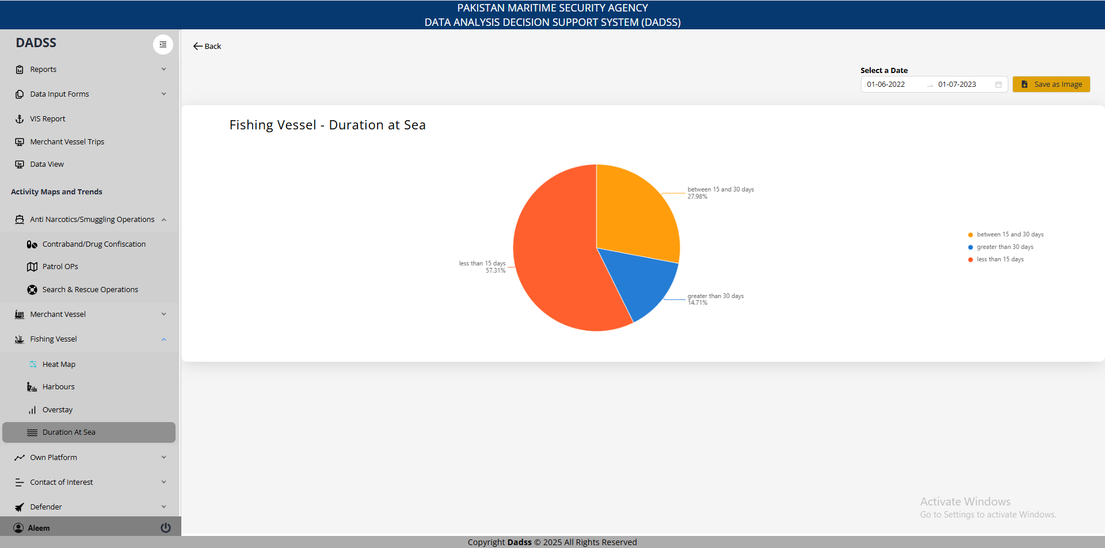
11. FVs Duration At Sea

Slide 33
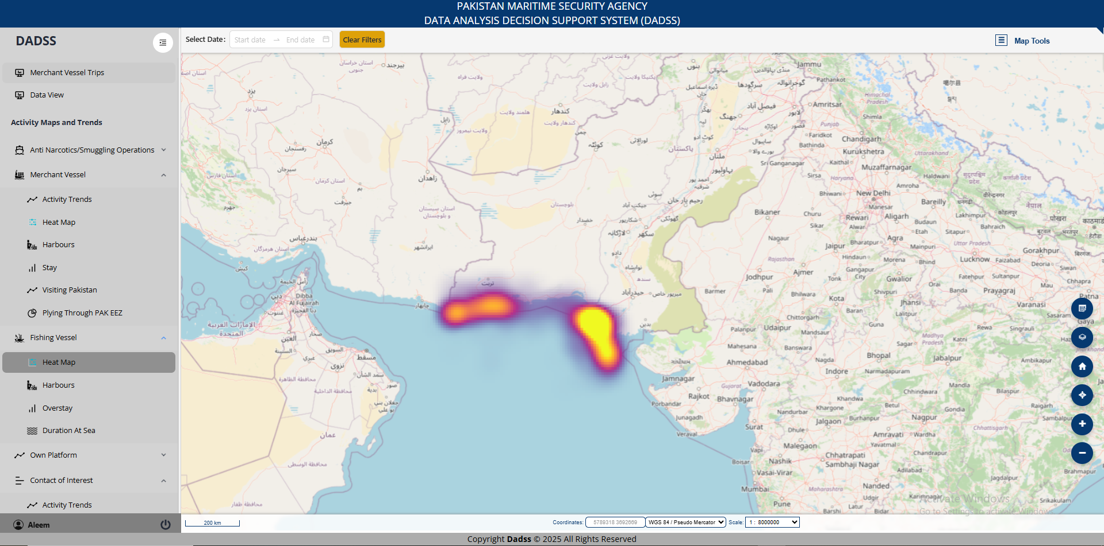
12. FVs Heatmap (VIS)

Slide 34
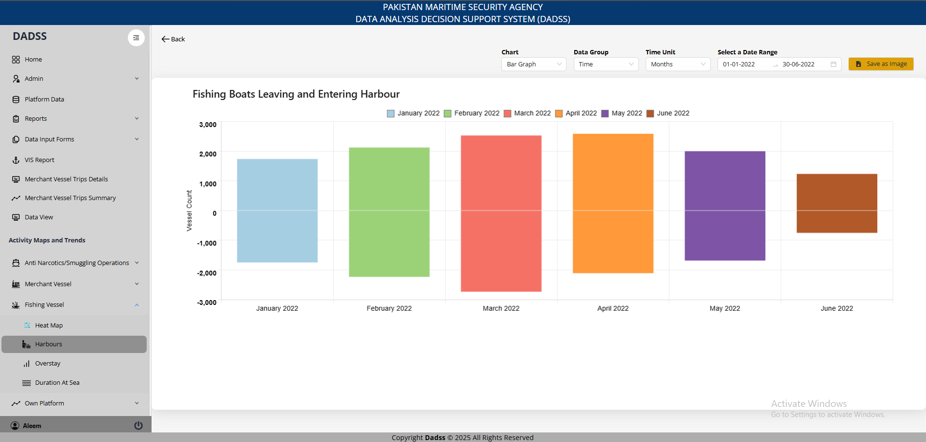
13. FVs Entering/Leaving

Slide 35
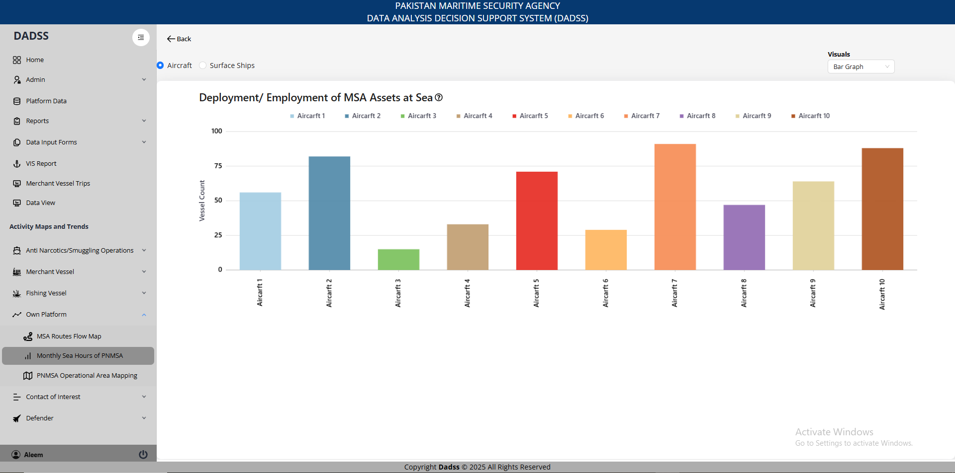
14. MSA Assets Deployed/Employed at Sea

Slide 36
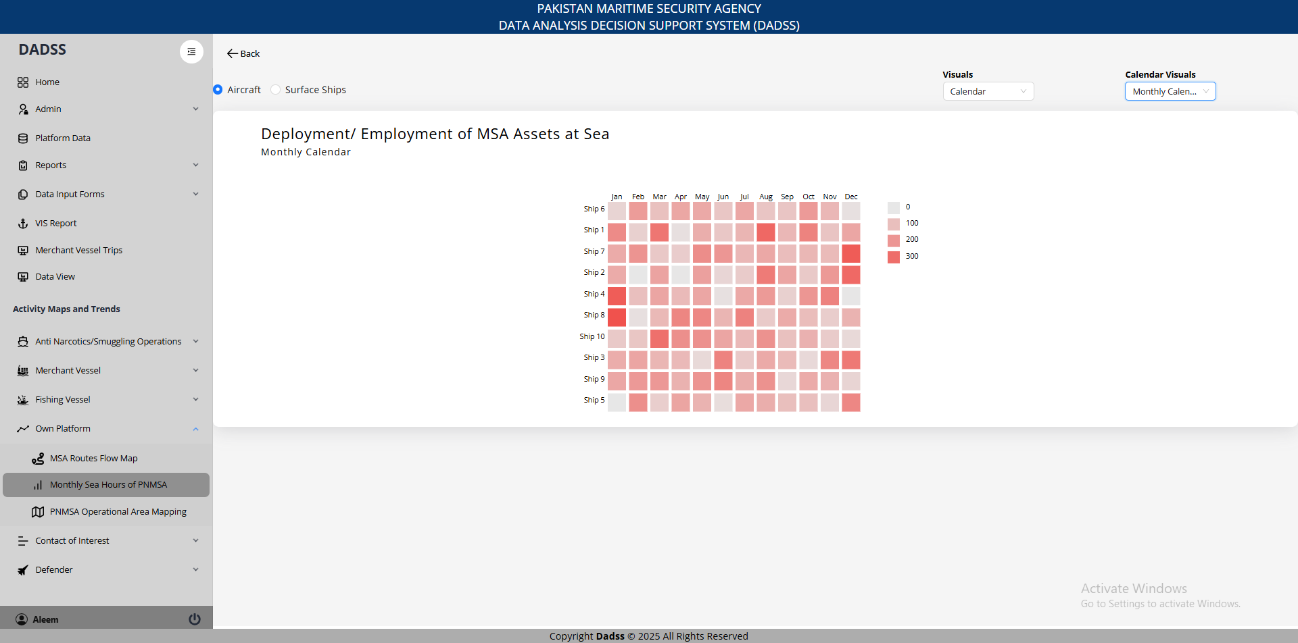
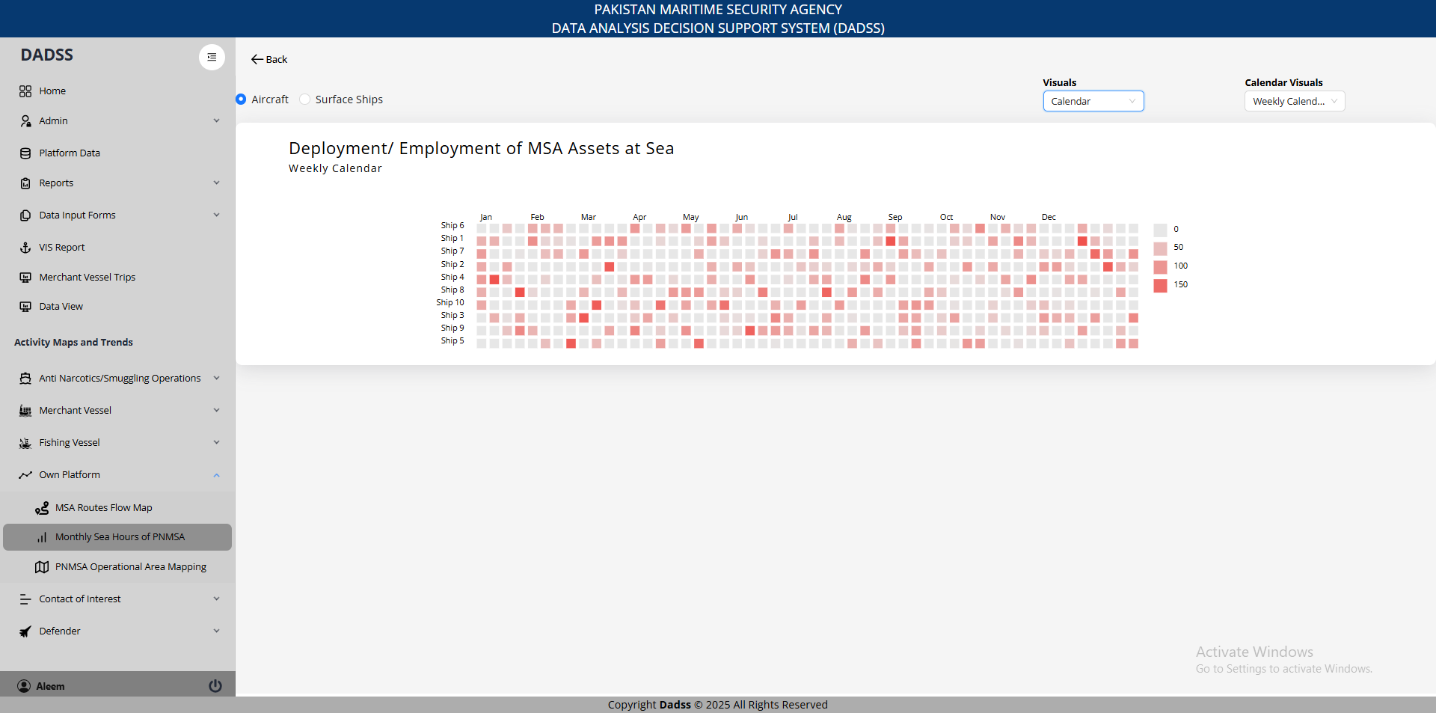
14. MSA Assets Deployed/Employed at Sea

Slide 37
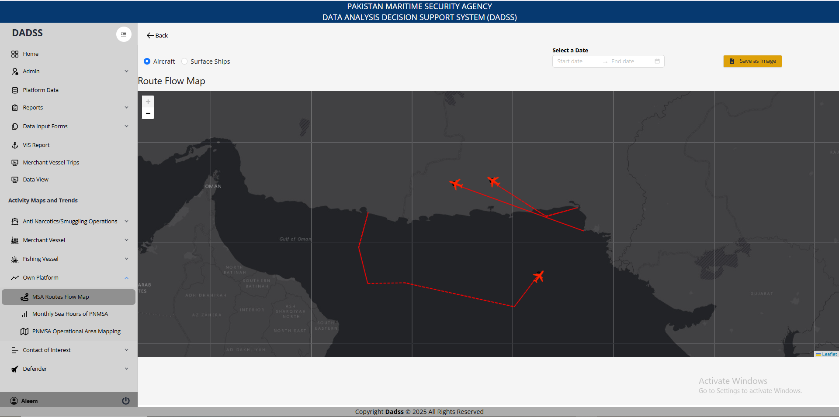
15. MSA Assets Routes

Slide 38
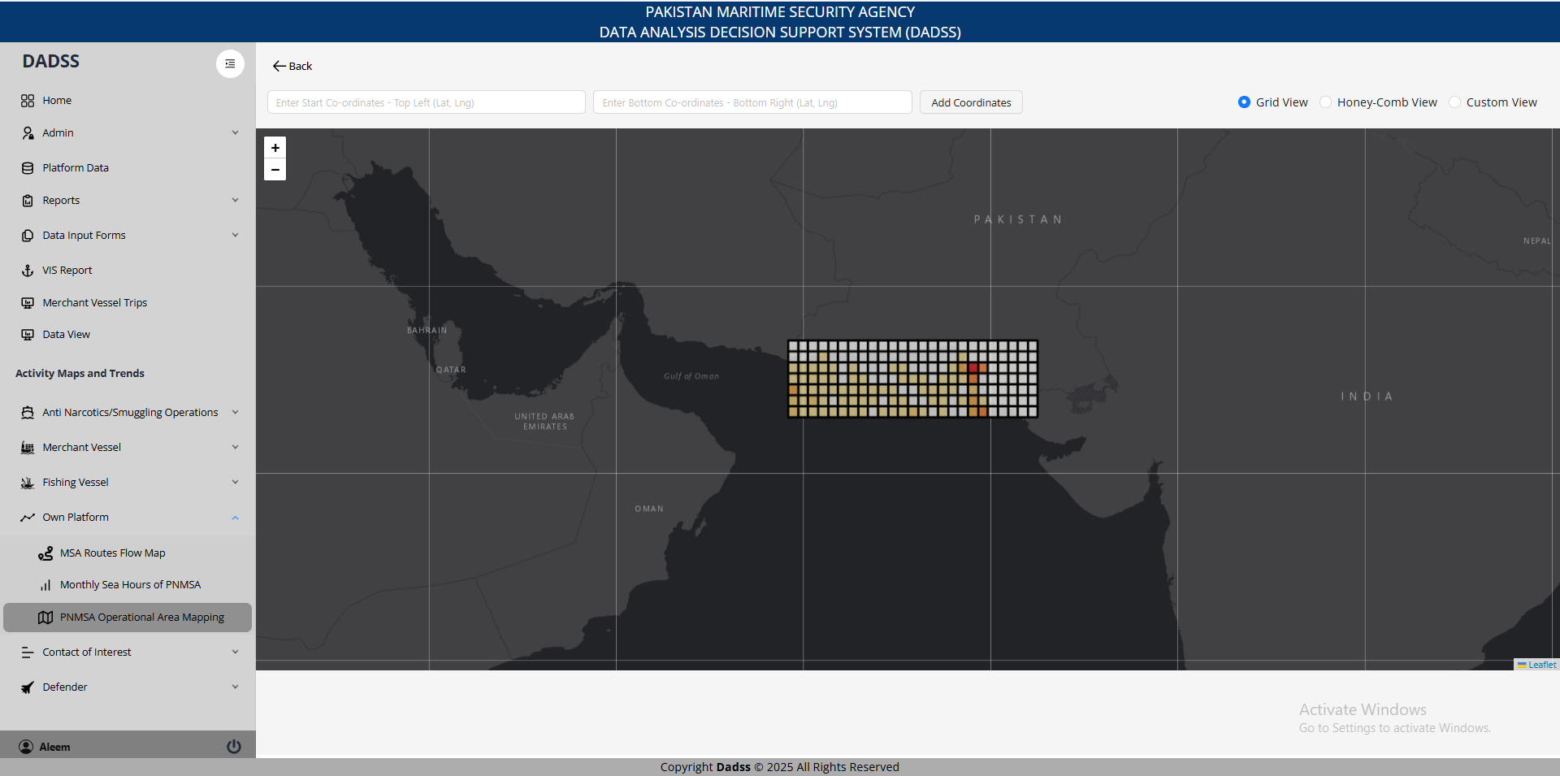
16. MSA Operational Area Mapping

Slide 39
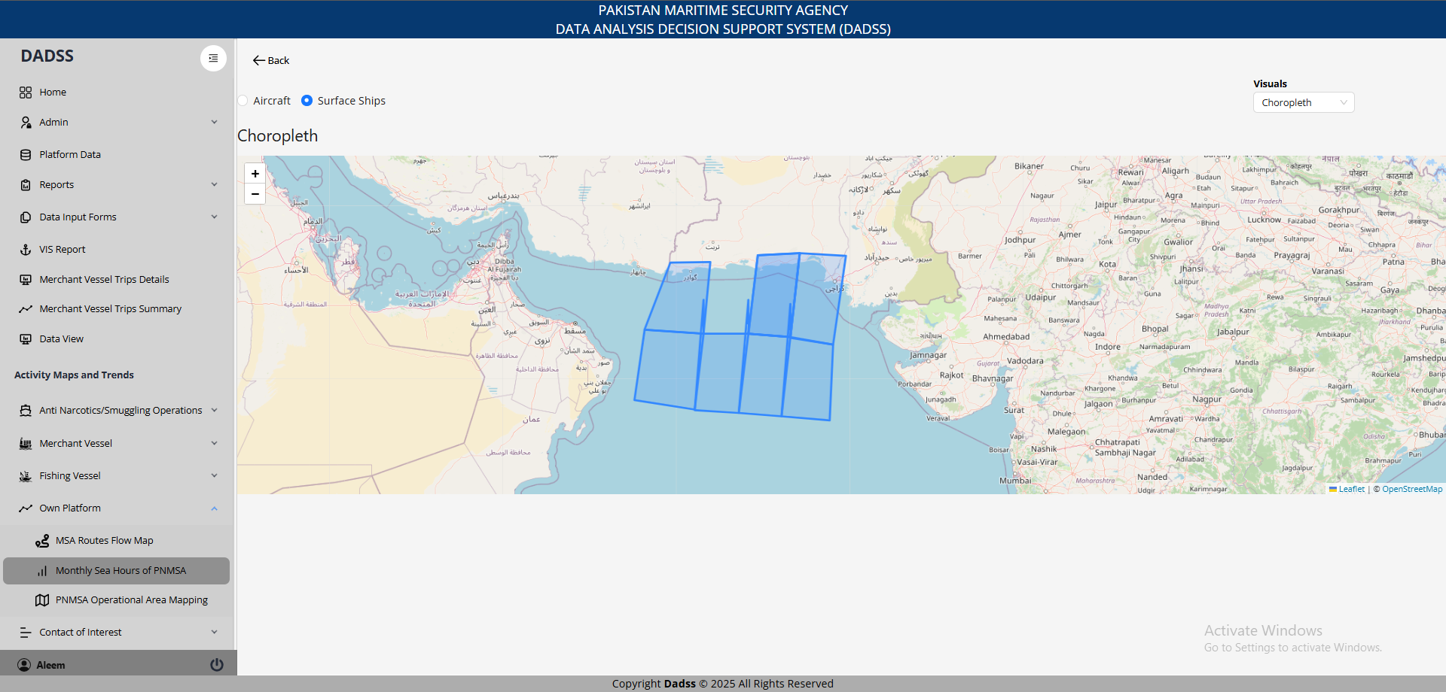
17. Choropleth

Slide 40
THE END

